Slide 1
Capstone Project Presentation on Credit Card Default Prediction
Presented by : 1. Priyabrata Mohanty
2. Rahul Sharma

Slide 2
Agenda
Problem statement
Objective
Data summary
Data cleaning
Machine learning model building
Conclusion
Appendix
Data Sources
Data Assumptions

Slide 3
Problem statement
To analyse the past credit card transections of different users and to predict whether a customer will default on his/her credit card.

Slide 4
Data summary
The dataset contains the information about past credit card transections of different users.
It contains 25 features and 30,000 observations.
Important features:-
X1 : Amount of the given credits.
X2: Gender(Male/Female)
X3: Education (1 = graduate school; 2 = university; 3 = high school; 4 = others)
X4: Marital status (1 = married; 2 = single; 3 = others)
X5: Age(Year)
X6 - X11: History of past payments.(April To September)
X12 – X17: Amount of bill statement(September To April)
X18 – X23: Amount of previous payment(September To April)

Slide 5
Data cleaning & Processing
There were classes in the variables with close to very less proportion to observations. They were added to their closest majority class(Features: Education, Marriage).
There were zero null values in the dataset.
Categories starting with 1 were to be started at zero(Feature: Sex).

Slide 6
Exploratory Data analysis

Slide 7
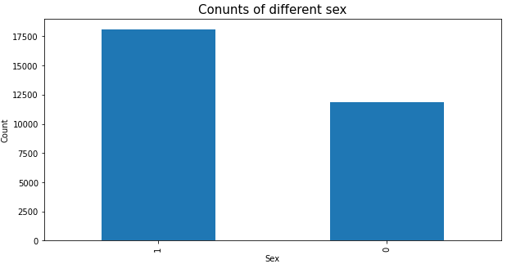
According to above graphs:
More female users were default in the credit card payment as compared to Male users.
1: Female
0: Male

Slide 8
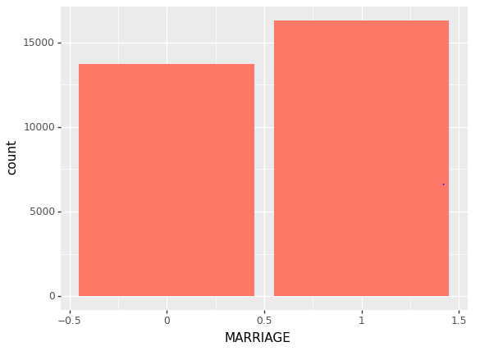
According to the above graph:
The dataset contains more Married group as compared to the other groups.
0: Married
1: Single

Slide 9
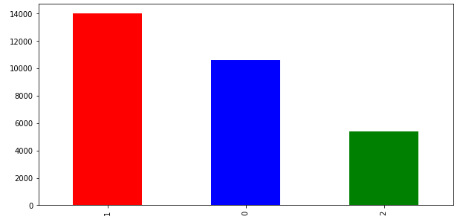
According to above graph:
Highest number of users have attended the University.
EDUCATION LEVEL
0: Graduate
1: University
2: Higher school

Slide 10
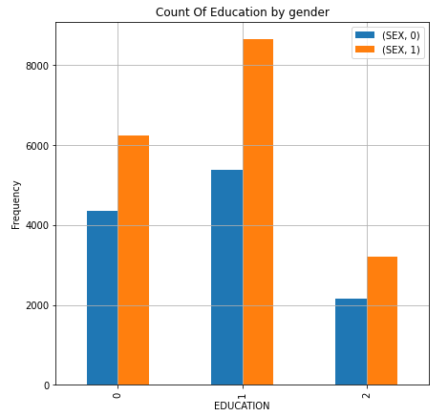
According to the above graph:
We can see that the people with University level education are highest in numbers and those are Females.

Slide 11
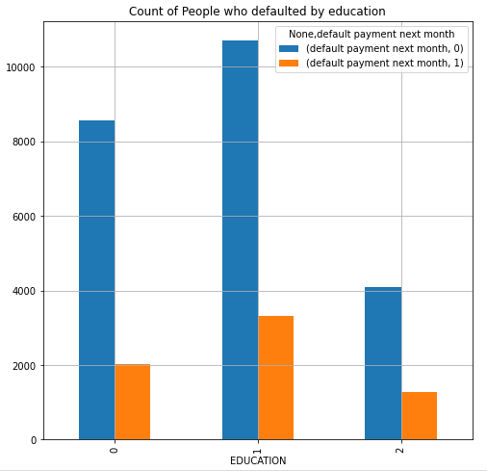
According to the above graph:
The users who have gone University, have made their default payments and simultaneously non-default count is also high for this class.

Slide 12
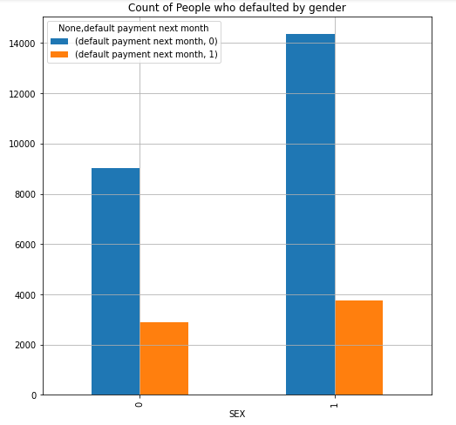
According to the above graph:
We can see that, the female group users are the most default for credit card payment.

Slide 13
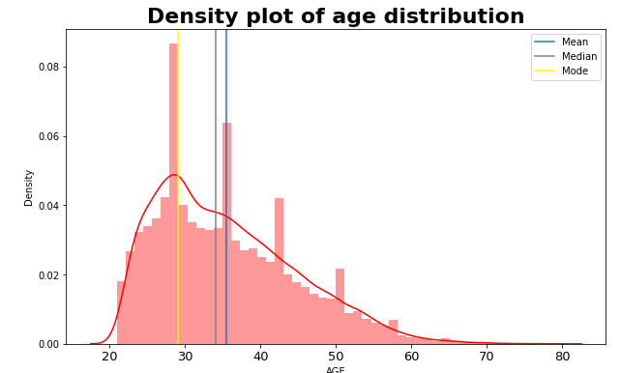
According to this graph:
The data are Right skewed.
Mean is greater than the median.
Most People were aged around 30.

Slide 14
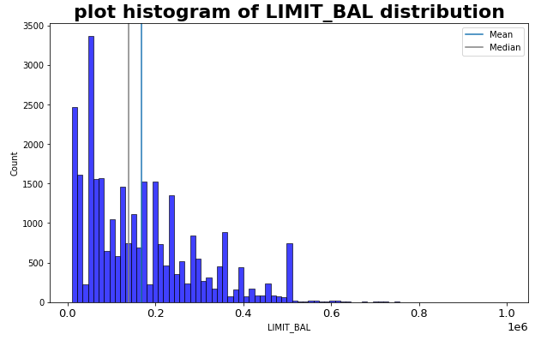
According to the above graph:
Mean is greater than median.
Heavy tailed data
The data are Right skewed.

Slide 15
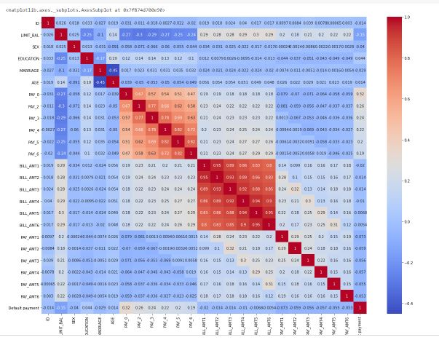

Slide 16
Machine Learning Model Insights
Logistic Regression
The First of all we tried Logistic Regression. The model was too simple and was not able to perform that well.
The model’s Accuracy score for Training dataset was only 0.777 & for the Test dataset 0.783.
We had to make our model more complex for better discretion. So moved to Decision Tree, Gradient Boosting Classifier for better results.

Slide 17
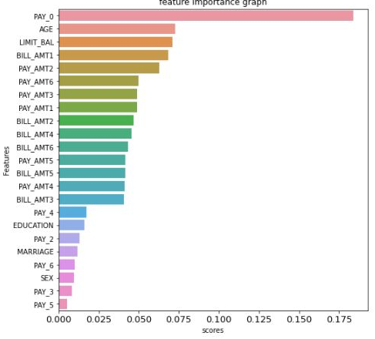
Decision Tree Classification
According to the above graph:
The PAY_0(Payment record of April) is the most imp feature.
the accuracy was around 80% on train and test data set.

Slide 18
Gradient Boost Classifier
According to the above graph:
PAY_0 is the most important feature.
Accuracy of this model was 82% on test and 84 % on train dataset.

Slide 19
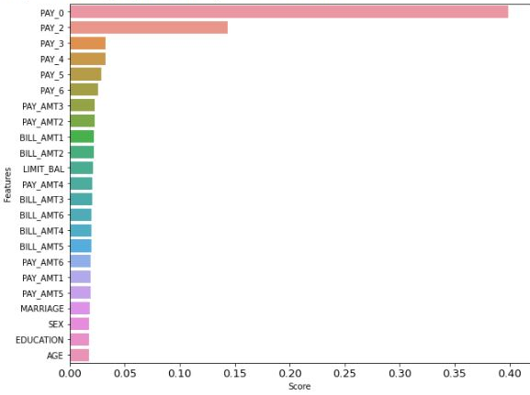
XGBoost Classifier
According to the above graph:
The PAY_0(Payment record of April) most important feature.
Accuracy score on train dataset was 0.92.
Accuracy score on train dataset was 0.816.

Slide 20
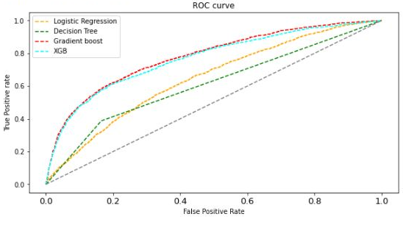
ROC Curve
According to the above graph:
The ROC-AUC of Gradient boost and Xgboost algorithms are same.
Model at 60% true positive rate gives around 17% of False positive results.

Slide 21
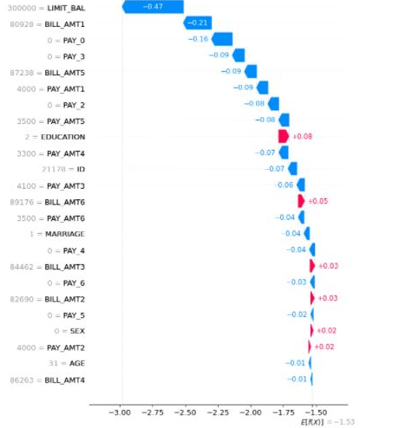
Waterfall Model
The bottom of a waterfall plot starts as the expected value of the model output, and then each row shows how the positive (red) or negative (blue) contribution of each feature moves the value from the expected model output over the background dataset to the model output for this prediction.

Slide 22
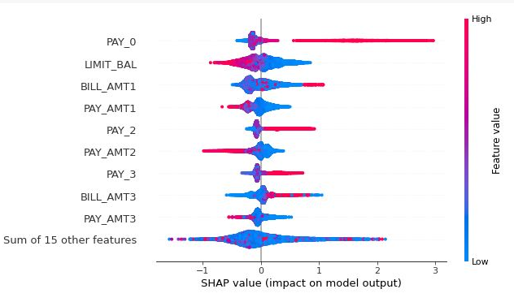
According to the above graph:
The PAY_0(Payment record of April) most important feature as it has the highest shap value.
Shap Plot ( Impact On Model Output)

Slide 23
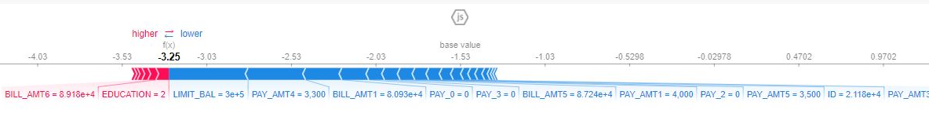
Force Plot
Features pushing the prediction higher are in red like Education & BILL_AMT6.
Features which are in blue are lowering the prediction like LIMIT_BAL & PAY_AMT4.

Slide 24
Conclusion
The Data categorical variables had minority classes which were added to their closest majority class
People who studied the higher University education defaulted the most.
People who had an University level education were most in the numbers.
Logistic regression Accuracy were 78% on test data. It over-fitted with 1% with respect to train accuracy.
Gradient boost gave the highest accuracy of 82% on test dataset.
Repayment in the month of September i.e. PAY_0 tended to be the most important feature for our machine learning model.

Slide 25
Appendix - Data sources
Here is a snapshot of data dictionary.
Basic user information such as:
Gender, Age, Education, Marital status
Previous transaction details such as:
Amount of given credit, History of payments, Payment delay for months.
We used the past user transaction dataset.

Slide 26
Appendix - Data Methodology
We conducted a thorough analysis & prediction of the default credit card payment. The process includes:
Data cleaning – Removal of class mismatch of features, proper categorization.
Correlation -Finding correlation between the different parameters
EDA - Understanding data using different methods
ML Modelling – Built & tested the machine learning models to predict default credit card payment.

Slide 27
Thank You !

